Slide 1
Why is persistently identifying your software a good idea?
Catherine Jones
Software Engineering Group Leader
STFC
September 2016

Slide 2

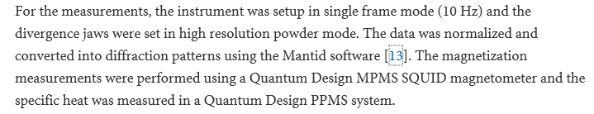
Software
Software is complicated with many dependencies
Writing software is an intellectual endeavour
Software should be recognised as a first class object and credited appropriately
  To do this, you need to know what you are referring to

Slide 3
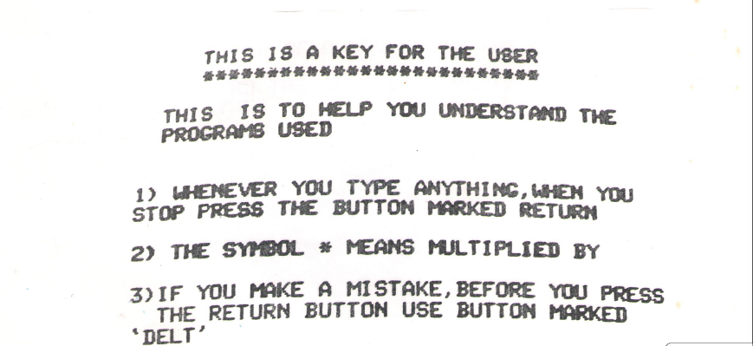

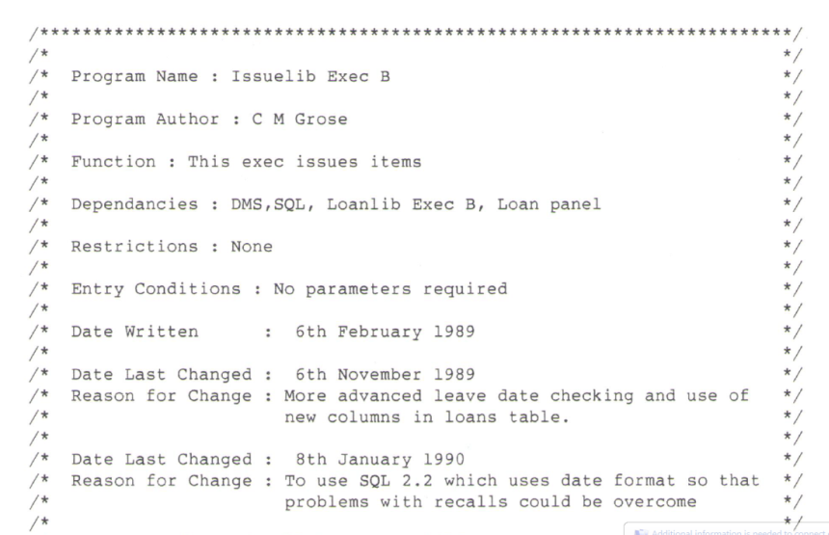
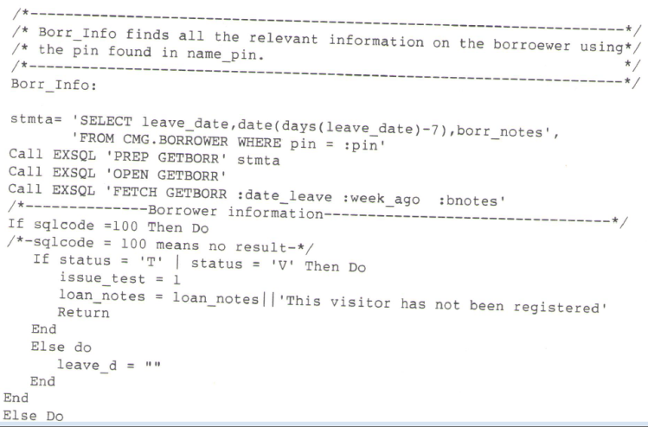
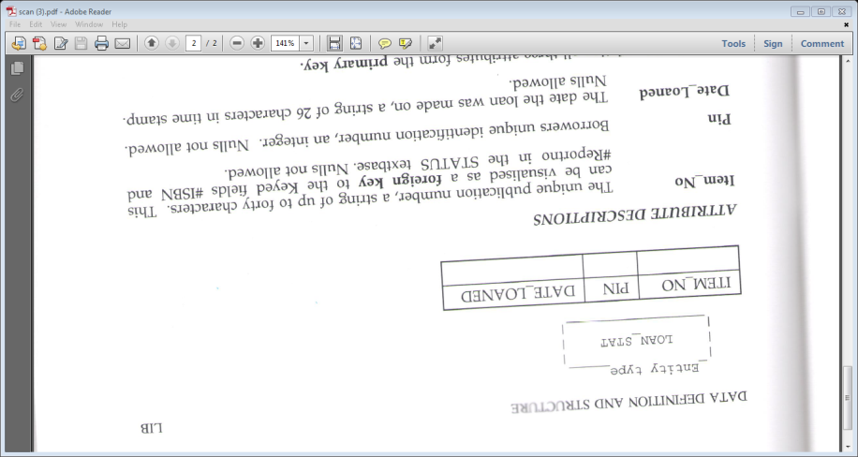
Why am I interested?
I once wrote software……using software engineering best practice at the time
Only printouts of photographs of the screen remain, 5 1/4 ” disc long gone….
Electronic objects need active management for them to survive and thrive – persistent identification is an aspect of that management
Computing “A” level project 1983 – BBC Micro & Basic
I kept these because they were part of my intellectual record… even though they didn’t underpin a publication or scientific discovery….
Only printouts of a couple of programmes and the original specification documents remain with some postscript files of the documentation. IBM 3090 VM/CMS long gone…..
5 years of Database Applications Analyst/Programmer c.1990 –IBM 3090 VM & Rexx

Slide 4
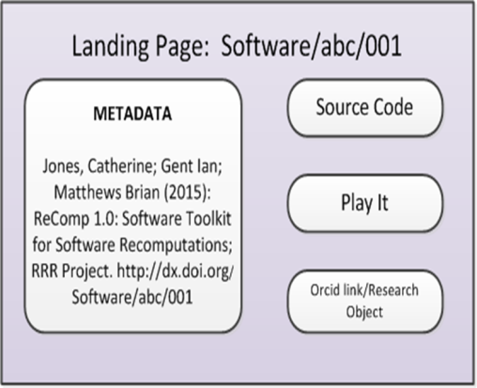
Software RRR: Aims
Jisc funded Software Re-use, Re-purposing and Reproducibility project looked at how the DOI metadata schema should be applied to software written in an academic environment and explored capturing software in a running state.

Slide 5

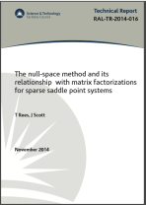
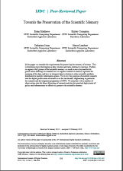
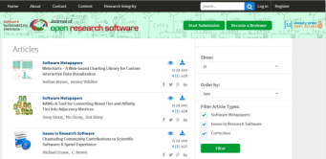
What do we mean by software?
Software is a general term, scale can vary from:
  One off script (post-it note?)
  Script used on a regular basis (technical report?)
  Complete programme providing a set of functionality (journal article?)
  Suite of programmes providing a wider range of functionalities (Journal issue?)
It will have dependencies
It can be written from scratch or a modification of existing code

Slide 6
What do we mean by persistent identification?
Assigning an identifier which
  Is unique - no confusion
  Always brings back the same object – same version
  Will always resolve - even if the object is no longer available
  Is independent of the current location/system of the object
There are many persistent identifier schemes & services
  DOIs, Handles etc.
  Services such as GitHub/Zenodo and Figshare
They all need good quality metadata to be effective
BUT not everything needs persistently identifying

Slide 7
Why persistently identify software?
used in a specific circumstance for use or reuse
Citation & appropriate credit
rerun the correct software to verify results
distinguish between different versions

Slide 8
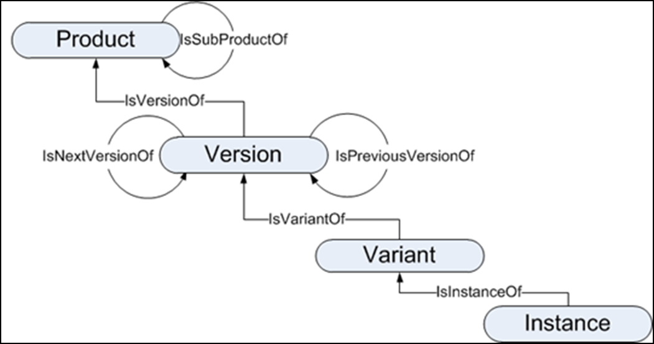
What is being Identified?
the concept
Specific version, defined functionality
Any of these may be needed to be persistently identified depending on the situation
On my machine
Specific version for a specific operating system

Slide 9
Example: Mantid
Mantid is an open source development for data analysis in the Neutron Scattering Community with a large software development team
Approach
  Product level DOI for the concept of the software
  Each new version has its own DOI, crediting those who worked on that version.
    Uses IsPartOf to link back to the Product and IsNextVersion/IsPreviousVersion to relate version levels
Users of the software can cite the software version used for the analysis.

Slide 10
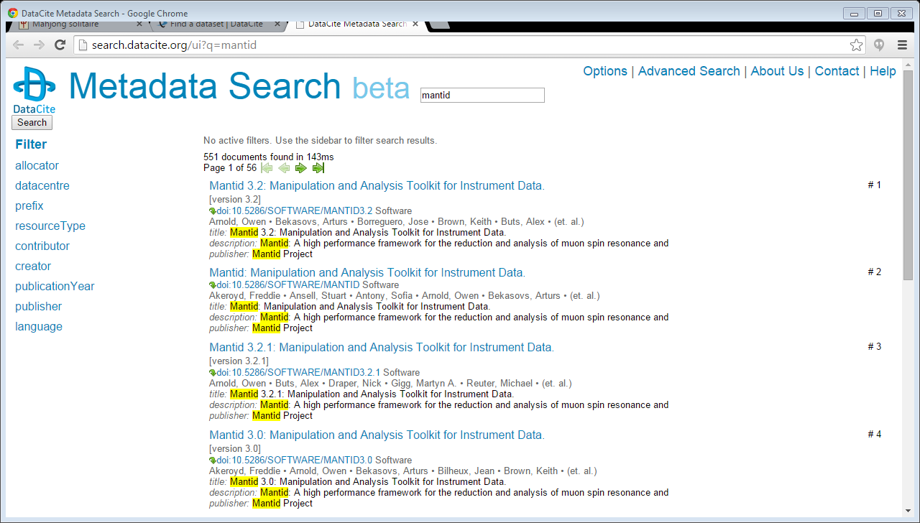
Real life example

Slide 11
Finding & (Re)Using software
To be able to find & reuse software the following information may be needed:
  Purpose
  Programming language
  Environment
  Who wrote it
  Where can I find it?
  What license is it issued under?
Much of this can be described in the metadata for the persistent identifier

Slide 12
Metadata and DOIs

Slide 13
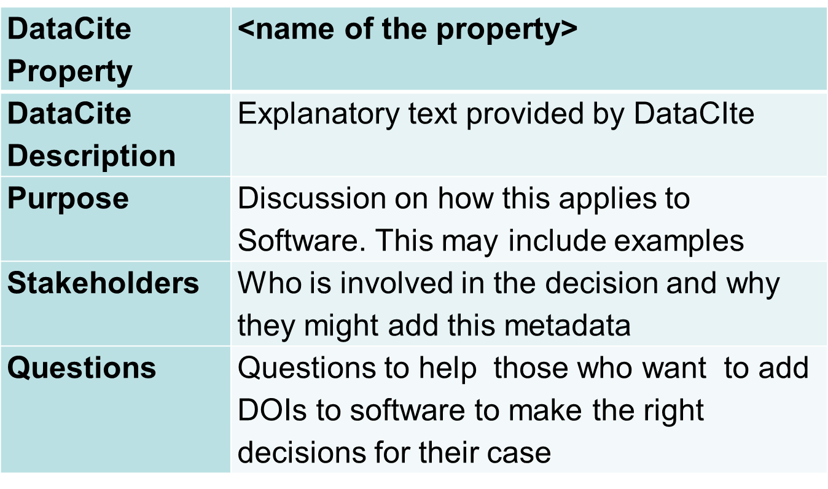
DataCite metadata
Report: http://purl.org/net/epubs/work/24058274
Gave guidance on how to apply DataCite to software

Slide 14
DataCite Creator
Purpose: to identify the people responsible for the creation of software
The creator may not be a straightforward item to ascertain as software has a long life-span and may be worked on by many people.
The point during the development cycle that the first DOI is given may also affect those identified as creators.
Knowing who wrote the software can be an important part of deciding relevance and trustworthiness

Slide 15
DataCite Creator Examples
Student project/single developer
Project team – DOI on first production release
  The current team should be straightforward to identify.
Project team - DOI after years of production releases
  It may be hard to identify all those who contributed to creating the software. The current release’s team will have built on the work of others.
Project team – DOI for every major version
  The creators for each DOI can reflect those who contributed to that specific version and the versions can be related through relationships.

Slide 16
DataCite Title
Mandatory field with the most text….
Questions….
  If it a piece of software written by a single person for a specific project does it actually have a (meaningful) name?
  Is the official name different from the common name?
  What effect is versioning or branching of code going to have on the name?
  Will the name used be unique enough for it to be found and distinguished from other search results?
Being able to understand what the software is, and how it relates to other versions can be important for discovery

Slide 17
DataCite Description
Additional field to add extra information to be used for discovery and understanding
Abstract and Other most commonly used DescriptionType to describe the purpose of the software or where the live code is
We suggested new DescriptionType of TechnicalInfo
  Will be in Version 4 of the DataCite Schema
  Discussions with GitHub & Zenodo about implementing this
More information helps others to understand the context faster

Slide 18
DataCite Relation type
This is an area which software doesn’t map well to
  Very publication focussed, so application to software twists the meanings
  IsCompiledBy and Compiles are not used in the computing sense
DataCite WG looking at this
Important to understand how different objects fit together – versions, modules, branches etc

Slide 19
Conclusions and Next Steps
Persistent Identification needs accurate & thoughtful metadata
For persistent identification and citation to become commonplace, culture around software credit needs to change
  Possibilities of linking this to measuring the success of software
Challenges for long-lived software and software modified by third parties
Other community activities: CodeMeta; Force11 Software Citation Group; DOI Metadata WG

Slide 20
Thanks
My Software RRR collaborators:
  Ian Gent, St Andrews,
  Jonathan Tedds, Leicester (Phase II),
  Brian Matthews, Steven Lamerton, Tom Griffin and Paulina Lach, STFC
Interested to collaborate with others in this area
Contact details: catherine.jones@stfc.ac.uk

