Slide 1



Data Sharing challenges for Energy Modellers: outcomes of a workshop
Catherine Jones & EDC Team
September 2025
Catherine.jones@stfc.ac.uk
Presentation CC-BY
Notes:
The abstract pattern can be removed or repositioned if required. Be careful to ‘Send to Back’ so that it does not obscure any important information.

Slide 2

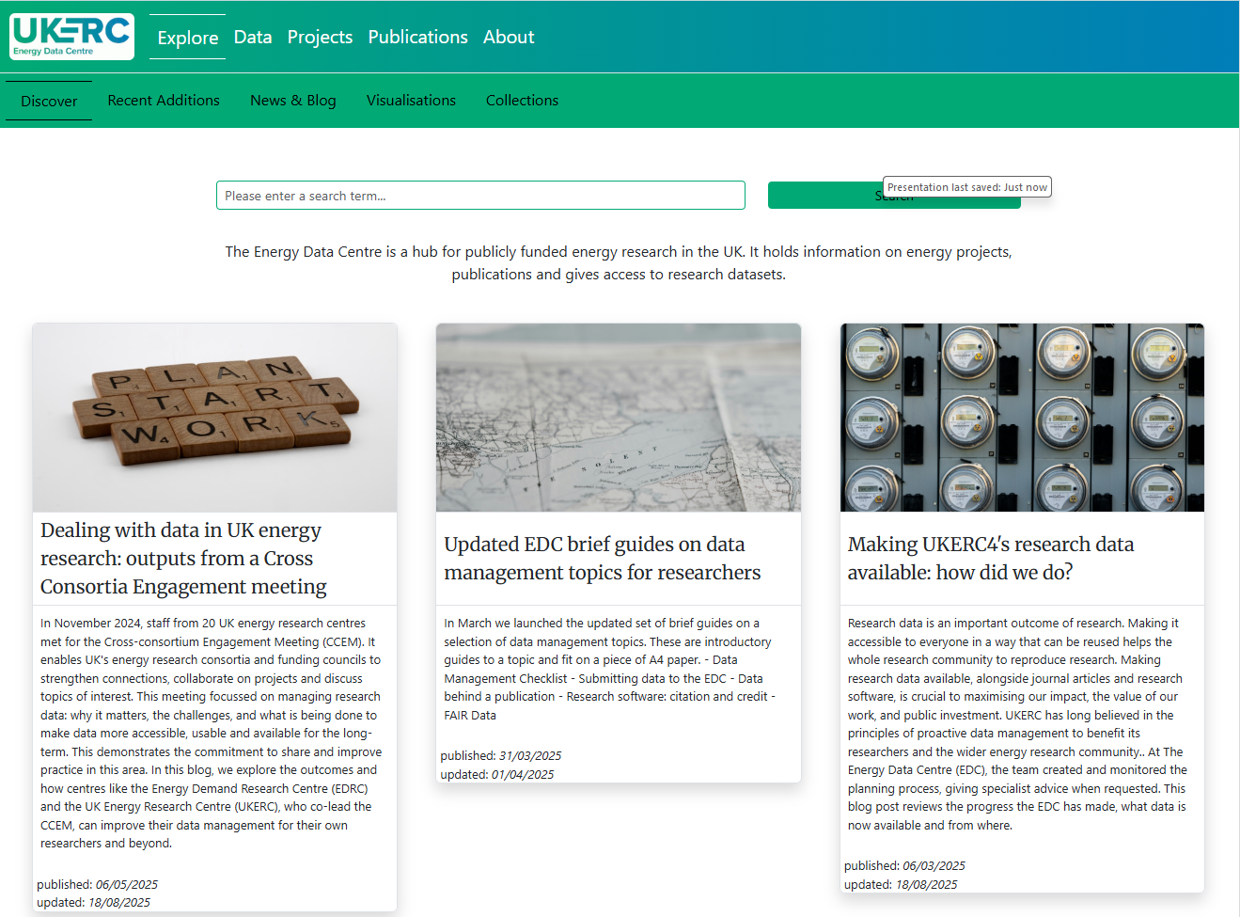
Background
UK Energy Research Centre (UKERC) www.ukerc.ac.uk
Independent whole systems research for a sustainable energy future
Energy Data Centre: expert team + discovery portal + research data curation
Responsible for Data Management Planning for UKERC
Energy modelling key to UKERC outputs
Access to energy information, now and for the future
Data Infrastructure for National Infrastructures
DSIT funded research data cloud project
Barriers to researchers sharing data
Project activities: landscape review, case studies, workshops, technical exploration
www.ukerc.rl.ac.uk

Slide 3
What is “special” about Energy research?
Very multidisciplinary leading to
Different expectations/practices
Different repositories
Cultural change works at different paces in different domains
Several large consortia as well as smaller projects
Energy sector is a heavy user of commercial “real-world” data
Interesting (mostly) domain challenges around the data itself:
Elite interviews
Models
Jupyter notebooks

Slide 4
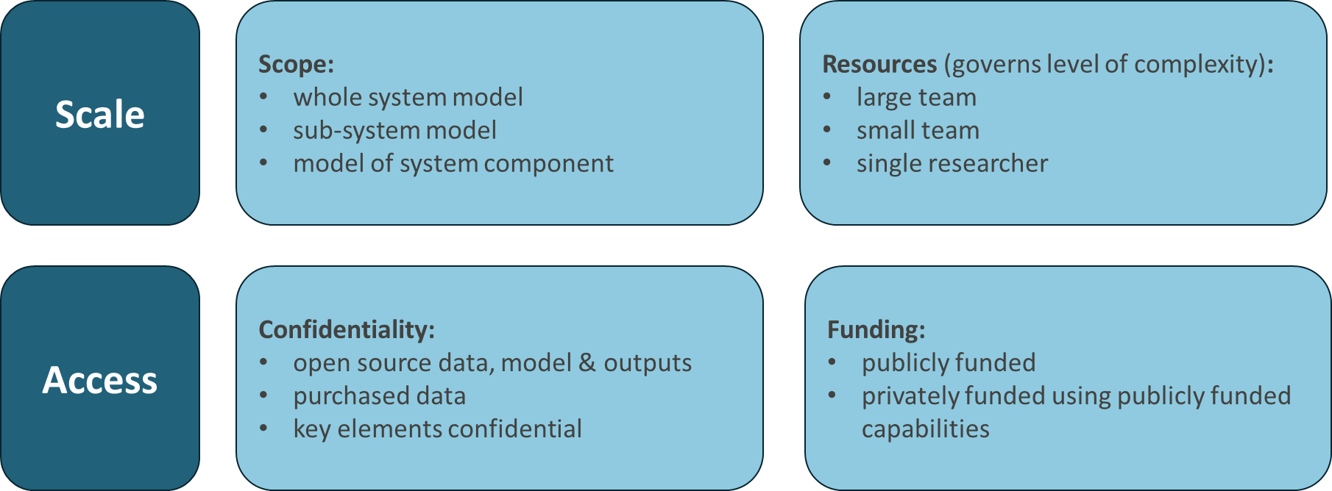
Why energy modelling is important
Tool/approach which impacts on real-life decisions: used by academics, government and industry
Need to be able to keep both the record of results & the process (input data/settings, model version etc)
One size won’t fit all
Many scales of model & resourcing
Many scales of volume of data
Different restrictions
2024 Workshop aimed to explore current state of sharing, pinch points and successes
Report https://doi.org/10.5286/UKERC.EDC.000985
Follow on from 2023 CREDS/UKERC Data Sharing for Energy Consortia workshop
https://doi.org/10.5286/UKERC.EDC.000970 and https://doi.org/10.5286/UKERC.EDC.000971
Framing by Mike Colechin and Andy Boston

Slide 5
Key Issues identified
Findable
How emerging technology data , such as costs and environmental impact, becomes findable
Locating additional data for the inputs of models is time-consuming
Data availability, especially from commercial companies,
Tensions between concerns of export controls, protecting IP and protecting critical NI vs open and FAIR data
Interoperable
Bringing open source and commercially sensitive data together.
Data: formats, cleaning, documentation, standards
People collect and think about data in different ways, so the same kind of data may be recorded differently.
Reusable
Data quality
Some industry related data, can be considered to be a “data black box”
Models
Academic funding: a lack of support or incentives for creating models with longevity.
Importance of having communities around specific models
Longevity of the availability of data.
Accessible
Privacy concerns and confidentiality
Lack of knowledge of appropriate licensing
Inadequate documentation and metadata. Lack of common terminology
AI (for explainability).
Funding for community developed models maintained with project funding.
Effort needed to run and participate in communities
Ethical issues, such as those raised by smart meter data

Slide 6
Recommendations
Infrastructure
Establish requirements for a registry for energy models.
Guidance and support
Enhance EDC guidance on software citation to explicitly cover citation and referencing of models to support discoverability within the literature.
Produce and publicise guidance available from the EDC to support the creation of FAIR data to be used in modelling.
Energy Modelling community
Create a working group to review classifications of energy data for statistics. There could be a role for UKERC/EDC/ DAFNI as a convener of this activity.
Contribute to the AI adoption debate by writing a position paper on this topic, with input from DAFNI, UKERC and other collaborators.
There is an identified need for a central platform to share data, run models and facilitate communities, DINI should capture these requirements

