Slide 1



Investigating the impact of policy on energy consumption in the Energy Data Centre
Catherine Jones,
Energy Research Unit, Technology Department, UKRI/STFC
DPC Nov 2021
Notes:
The abstract pattern can be removed or repositioned if required. Be careful to ‘Send to Back’ so that it does not obscure any important information.

Slide 2
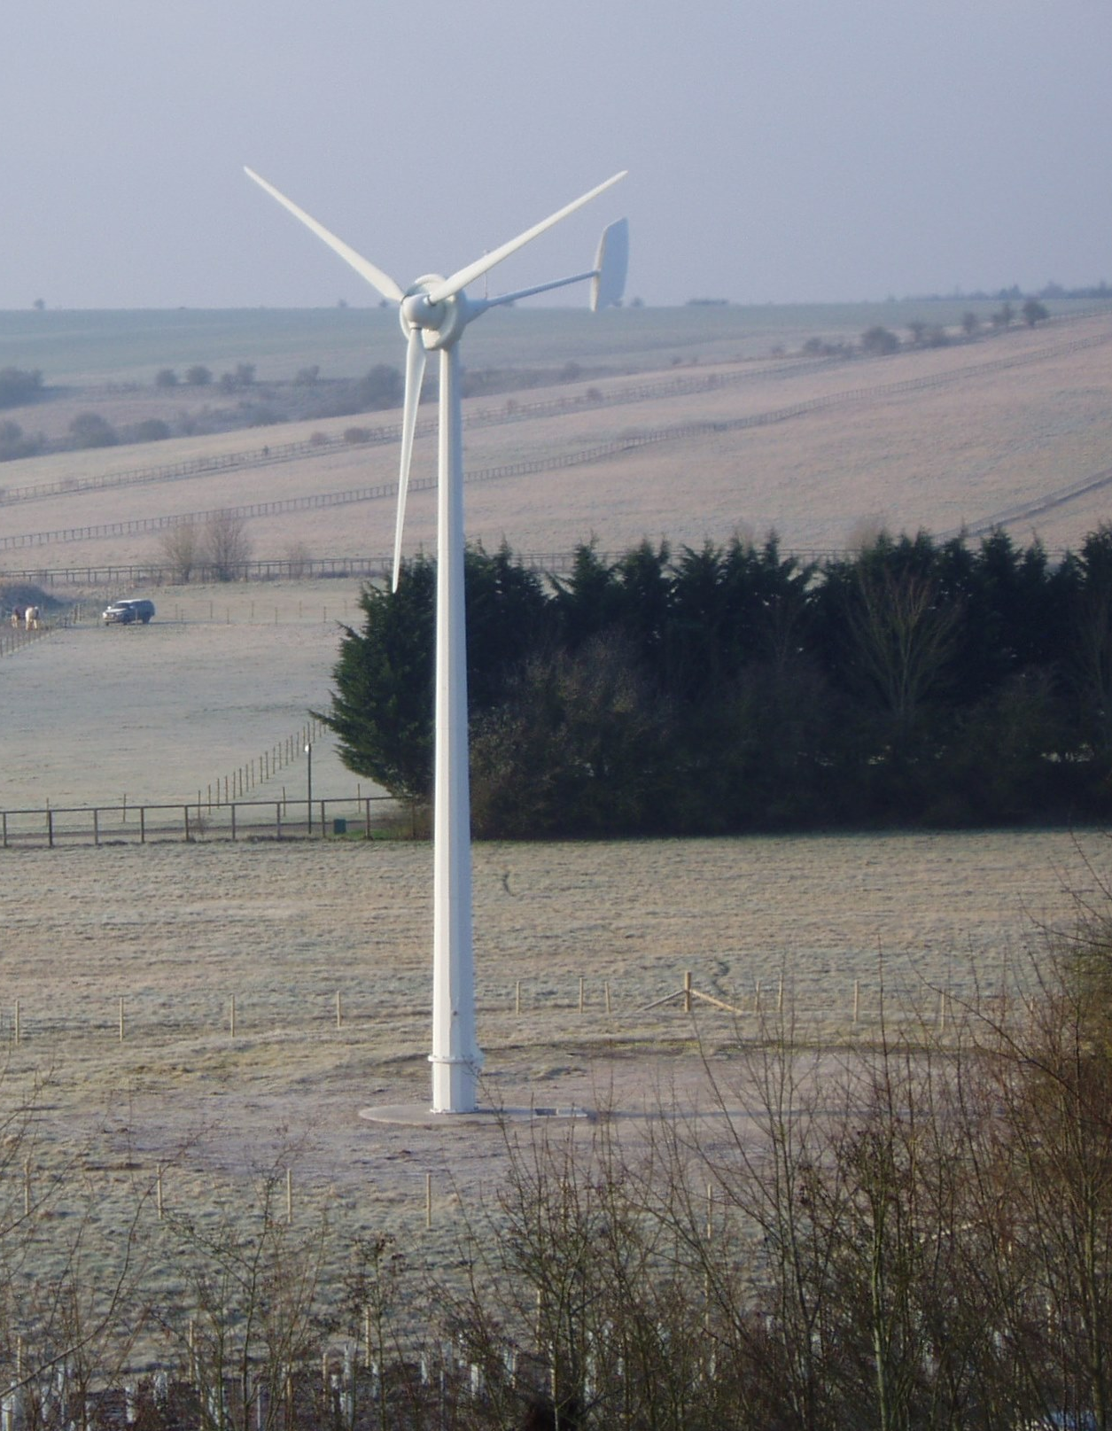
Energy Data Centre: introduction
Part of the UK Energy Research Centre, funded by UKRI
UKERC vision: Independent whole systems research for a sustainable energy future
EDC collects & disseminates: research data; publications and metadata on energy projects
Infrastructure:
  Small team: 3 FTEs
  Internal systems

Slide 3
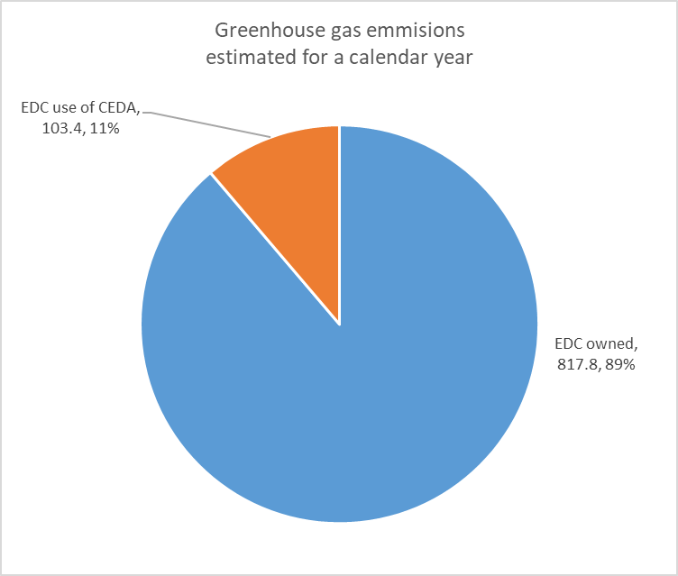
Internal Project
How does our policy affect our energy usage?
Reviewed service aspirations
  DPC RAM & TNA DiAGRAM (risk scenarios)
Measured energy usage for routine jobs
  Dell servers: IPMI tool (standard for sensor data)
  Analysed the outputs – did observe changes but very small numbers
  Worked out greenhouse gas emissions for the service
  Also ran new URL checking job
  All contributions make a small difference and put together makes a bigger difference.
This is equivalent to average car driving 3280 miles a year

Slide 4
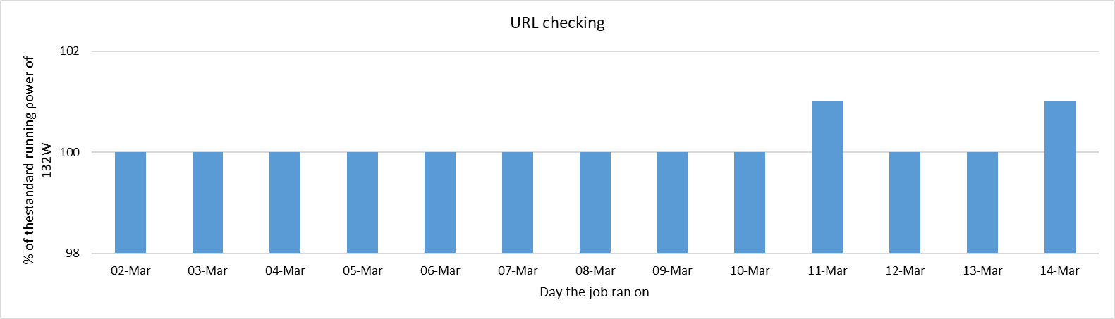
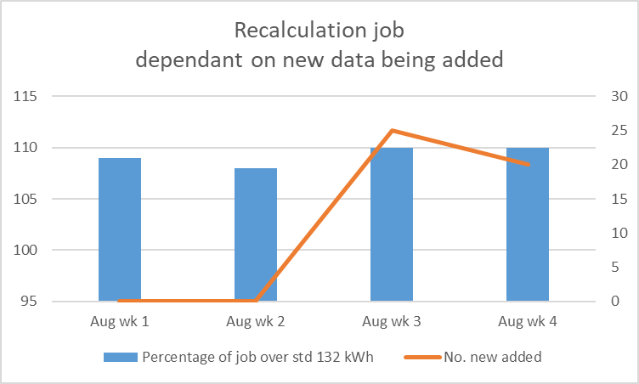
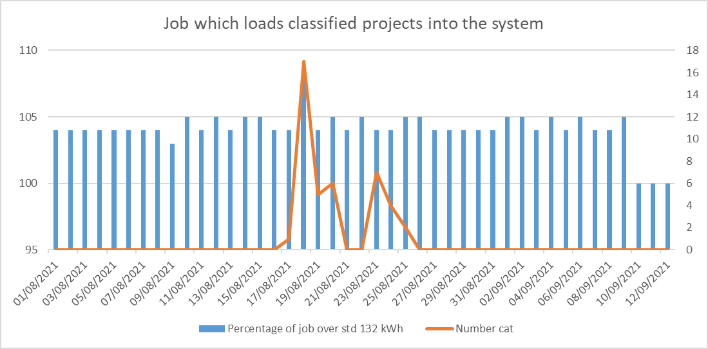
Routine jobs
Ingest and data quality activities (known times)
Measured baseline when jobs weren’t running.
Able to measure changes in power consumption – very small numbers
IPMI provides averages in steps: better data quality on jobs that took longer
Highlighted some jobs which run automatically but don’t always do anything if no new records
Regular URL checking now in place as a result
Accidentally left the energy data gathering going so now have 8 months worth of data!

Slide 5
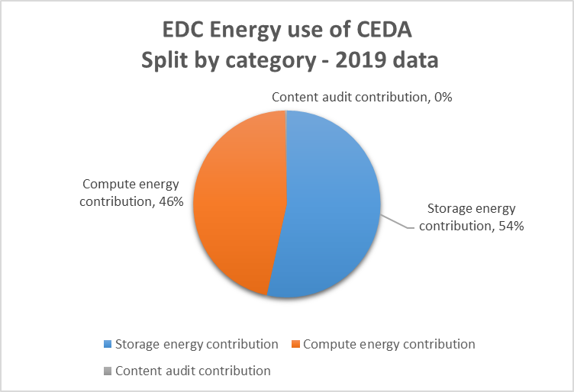
CEDA Component – research data
Not very much energy used in this part of the service – as expected. Would increase as data volumes increase.
Big computing (cloud/virtual) is more energy efficient than a couple of machines for a particular service
Calculated by working out proportion of storage & compute and knowing total energy consumption on JASMIN.
Figures & calculations provided by CEDA staff

Slide 6
Risk benefit discussion
Data validation: checksums & other activities vs reputational damage from losing something
Energy Consumption
Risk to content
Collections where we are the primary holder
Service reliability
Service response speed
Resourcing
Risk appetite for new architecture
Systems re-write /adaptions to be greener: needs technical effort
Reputational risk (& different processes/risk appetite)
Data on disk (fast) vs on taps (slower) but more energy efficient
Architecture reflecting risk appetite AND service specification/money
Cloud/big data centres (energy efficient) vs own kit (more control).

Slide 7
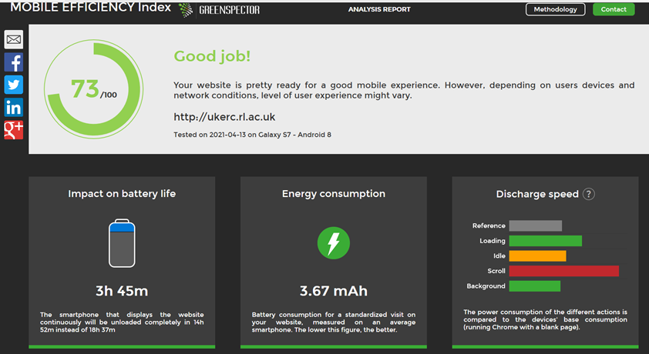
Conclusions
Measured energy consumption of routine jobs (with caveats)
Some new preservation risk mitigations won’t increase energy consumption
Demonstrated using large shared resources is more energy efficient (as expected)
EDC actions:
  Reviewed regular jobs
  Investigate checksums processes on low risk objects
  Investigate greening the web application
  Consider risk appetite for the infrastructure
  Add energy consumption dashboard functionality
https://mobile-efficiency-index.com/en/

Slide 8
Thanks
Peter Holt, Sarah James & Alan Ruddell from the Energy Research Unit, Technology Department, UKRI/STFC
Sam Pepler, Andrew Harwood & Matt Pritchard, Centre for Environmental Data Analytics based at UKRI/STFC
Chris Dean from UKRI/STFC Digital Infrastructure staff
Jen Mitcham & Paul Wheatley from DPC for advice & sense checking
David Underdown from TNA for advice on DiAGRAM
  All contributions make a small difference and put together makes a bigger difference.

