Slide 1

Scientific Software Engineering
A Story in Three Halves
0000-0003-4714-184X
26 May 2026
CC-BY 4.0
Dr Jens Jensen, Scientific Computing Department
Software Engineering Communitheme
Pronouns: he/him
Pronounced (English) |yens|, IPA [jɛns]
 | http://purl.org/net/epubs/work/65961940
For the reader coming to the slides after the talk, acronyms and abbreviations are explained at the end

Slide 2

Story
Software Engineering Challenges in Building Digital Twins to Explore Climate Crisis Mitigation in Urban Environments
150 years ago
today
Warming Stripes (150 years of global average temperature)
Prof. Ed Hawkins, National Centre for Atmospheric Science, Univ of Reading

Slide 3
Urban climate models
Climate emergency mitigation
Extreme heat/cold risks thousands of lives across Europe annually
  Problem is getting worse – extreme weather events more common
Often poverty related
  People cannot afford to heat homes in cold weather
Also threatens the infrastructure, eg electricity distribution
Can we protect and save lives?

Slide 4
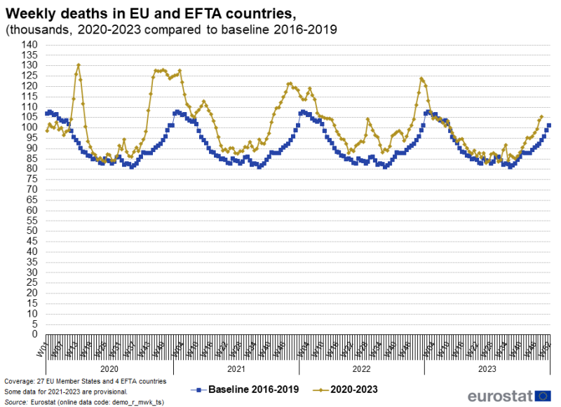
Excess Mortality (EU+EFTA)
Source: EuroStat
This is the pandemic!
(The UK is neither in EU nor in EFTA)
The point is: mortality is higher in the winter

Slide 5
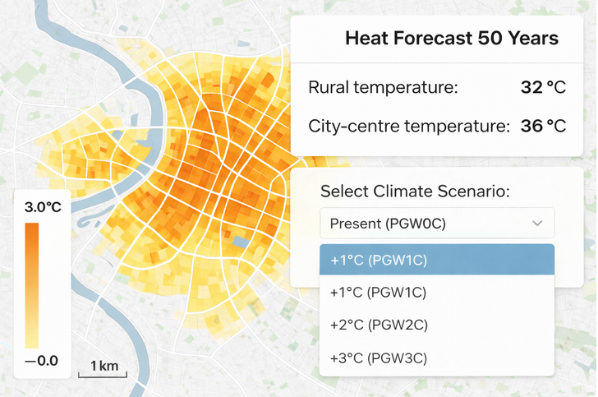
Digital Twins for Urban Development
Build Digital Twin models of cities
This one is Antwerp, Belgium
Image credit: UrbanAIR project
https://www.urbanair-project.eu/
This is obviously a heat model; a cold model would be implemented similarly

Slide 6
Extreme Heat – Measures
Short term
  Handle extreme temperatures – send vulnerable people to air conditioned buildings during the day
  Track vulnerable people – babies, elderly, pregnant
Medium term
  Make cities greener – plant more trees, green spaces
  Paint roofs to reflect sunlight, solar panels, green roofs
  Learn from hotter countries (siesta anyone?)
  Install air conditioning
Long term
  ?

Slide 7
Extreme Cold – Measures
Short term
  Financially support poorer people to heat (“winter fuel allowance”)
Medium term
  Insulate homes – walls, roof, doors and windows
  Improve heating
Long term
  ?

Slide 8
Complexity of Problem
Extreme Temperatures
Housing
Demographics
Climate
Urban environment
Local support

Slide 9
Complexity of Solution?
This Talk
RSE
HPC
Data Science

Slide 10
Data Science (digression)
Data scientist profile (from O’Neil and Schutt: Doing Data Science, O’Reilly)
Statistics
Computer Science
Maths
Domain Knowledge
Data Visualisation
Communication
Machine Learning
No single person has expertise in everything!

Slide 11
Challenge: Domain Knowledge
Lots of distinct domains!
Large data sets (climate data)
Processing large datasets on HPC, in data lakes
Climate datasets (GRIB, NetCDF, )
  Downscaling to city size resolution (typically need 2 metre)
Geospatial data (elevation, terrain, ) (CRS,…)
Urban data – roads, buildings, infrastructure (bridges, power), green areas, special buildings (hospitals, schools), vegetation
Building data – date built, construction, roof type/albedo, insulation, …
Demographics, behavioural (agent based) modelling
Physiology – human and non-human animals😳

Slide 12
The role of wind/airflow
Affected by the built environment
  And natural environment
  And the wind
Heat
  No wind in heat – stifling
Cold
  Windchill in cold weather – feels colder
LES models are popular
From dry bulb temperature to wet bulb globe temperature
  The latter takes into account airflow and humidity

Slide 13
Deployment
User
Data Repositories
Visualisation and Modelling
Airflow
simulation
Data Lake
Cloud (Data Lake)
HPC

Slide 14
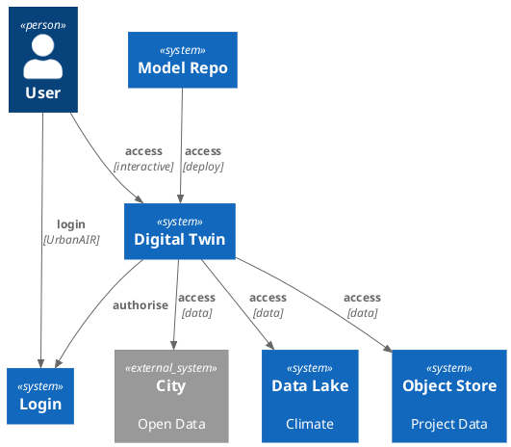
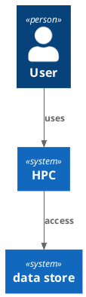
High Level Architecture

Slide 15
Soft Eng Challenge 1
Airflow Modelling (HPC)
Installing the airflow CFD modeller
  Written in Fortran 95, few bits of F77
  (Some) compilers don’t support later versions
  Designed to build and run on HPC – may need help from developers
  Requires MPI to build and run
  No standard build: different build path for each HPC system it’s built on
  No standard package system - not even Spack
  No regression test
Configure and run airflow models
  All config in a run-specific configuration file
  Specify all input and output files in the configuration file
  Runs only in batch mode

Slide 16
Soft Eng Challenge 2
Bridging the gap to HPC
  Airflow models take time to run
  HPC systems have different logins (usually one for each system)
  HPC (CFD) applications run in batch mode
  Not user friendly (command line,
  Getting access is difficult
Moving simulation results to DT?
  Who or what moves the data? Is it automatic 🤖?
  Who “owns” the data – can it be shared between users?

Slide 17
Soft Eng Challenge 3: reproducibility
The software must produce reproducible results

Slide 18
Parallel Skill Set for Science Software
Data Scientist
Finding Data
Maths
Stats – Exploratory
Stats – Analytics
Visualisation
Comp Sci
Comms
Domain/Domain data
Large data
Geospatial
Climate data
Moving data
Publish: QA
Publish: FAIR and/or Open
RSE
?
My own expansion of the original profile

Slide 19
Parallel Skill Set for Science Software
Data Scientist
Finding Data
Maths
Stats – Exploratory
Stats – Analytics
Visualisation
Comp Sci
Comms
Domain/Domain data
Large data
Geospatial
Climate data
Moving data
Publish: QA
Publish: FAIR and/or Open
Scientific Software Engineering
${language} best practice, QA
${language} state of the art
${language} dev methodology
Using AI
git
Numerology
HPC and Parallel/MPI
Perf / Optimise / Accelerators
Green Computing
Jira
Agile / SAFe Agile
Correctness
Licensing
Publishing Code / FAIR / Doc’d
My starter for 10
(no order)
Does not include specialist skills

Slide 20
Skill set breakdown 1: ${language}
Stay on top of language developments
  PEPs for Python – what’s coming up in 3.15 (May 2026)? in 3.16?
  Standards, Pxxxx for C++ – cppreference.com should be your browser home page
  Fortran – not just ISO/IEC, also community
Know best practices – you SHOULD apply them (RFC 2119)
  Linters are your friends
Know your IDE
  Everyone should (also) know Emacs and vi (vim, neovim)

Slide 21
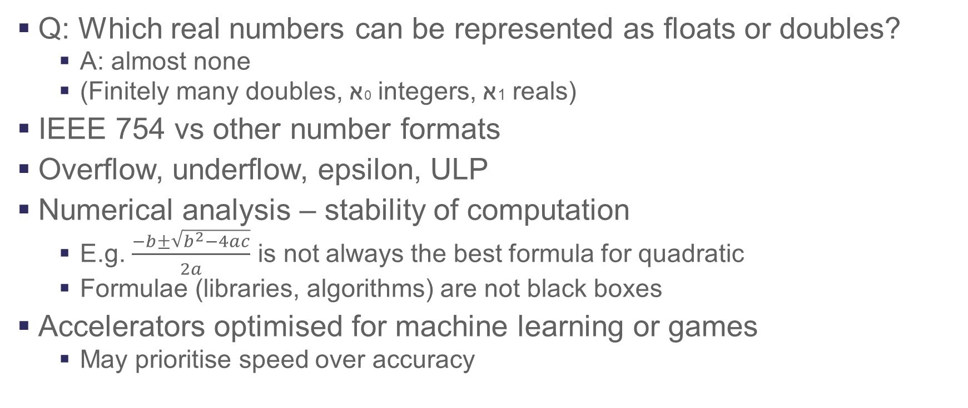
Skill set breakdown 2: numerology
Q: Which real numbers can be represented as floats or doubles?
  A: almost none
  (Finitely many doubles, א0 integers, א1 reals)
IEEE 754 vs other number formats
Overflow, underflow, epsilon, ULP
Numerical analysis – stability of computation
  E.g. $\frac{−b±\sqrt{b^{2}−4ac}}{2a}$ is not always the best formula for quadratic
  Formulae (libraries, algorithms) are not black boxes
Accelerators optimised for machine learning or games
  May prioritise speed over accuracy

Slide 22
Skill set breakdown 3: Correctness
?
Quick Hack
Air Traffic Control System
Correctness is expensive: how much time/money do we need to invest?
Correctness is complicated: see next slides
Correctness is

Slide 23
Skill set breakdown 3: Correctness
Requirements
  The does what the customer needs: models extreme temperature conditions and mitigations in ${city}
Specification
  The specifications passed to the Software Engineers is sufficiently detailed (functional and non-functional requirements)
Design: from “what” to “how”
Tests and Implementation (TDD)
  Unit tests, integration tests
Testing: UI/UX testing with Real Users™, modelling Antwerp
Continued support and development
Loosely based on

Slide 24
Skill set breakdown 3: Correctness
Mathematical correctness
  Formulae actually solve the CFD problem
Algorithmic correctness
  Algorithm implements the formulae
Usage correctness
  Code is called within expected parameter range
Runtime correctness
  Hardware executes code as intended
Validation of model
Semi-formal methods
  Loop invariants
  C++ contracts
Almost? formal methods
  LEAN is being used to model mathematical software
  lean-lang.org
Formal methods
  Z, Event-B, VDM, …

Slide 25
Specialist Skills?
Domain knowledge?
UI design
UX testing
Architecting software systems
  Is “architecting” a word?
(From “performance” to) low level optimisations
  CPU cache, vectorisation, …
  Low latency
Writing secure code?
Specialist skill:
Either: I don’t need this in my project
or
I can hire a consultant borrow an expert when I need it

Slide 26
Relevant Research Roles
Computational Scientist
  Provides domain expertise, writes code
Software Engineer
  General software engineering
Scientific Software Engineer
  Scientific software – numeric analysis, software for HPC
Research Software Engineer
  Software supporting research or as research, published software
Software Engineering Team Leader
  Leads a team that includes software engineers
Software Engineering Project Leader
  Leads a project that includes software engineering

Slide 27
Adding Augmented Agency:
Appending Additional Agile Actors
Scrum Master
Product Owner
Release Train Engineer
SAFe Practice Consultants
Business Owner

Slide 28
Skills/role matrix… (selected skills)
Role | Lang. best practice | Lang dev | Dev method | AI | git | Numbers | HPC | Jira | Agile | SAFe Agile
Comp Sci
Soft Eng
Lead developer
Sci Soft Eng
Research Soft Eng
Team lead
Proj lead
Scale:

Slide 29
Parallel Skill Set for Science Software
Data Scientist
Scientific Software Engineering
No single person knows everything
No single person knows everything

Slide 30
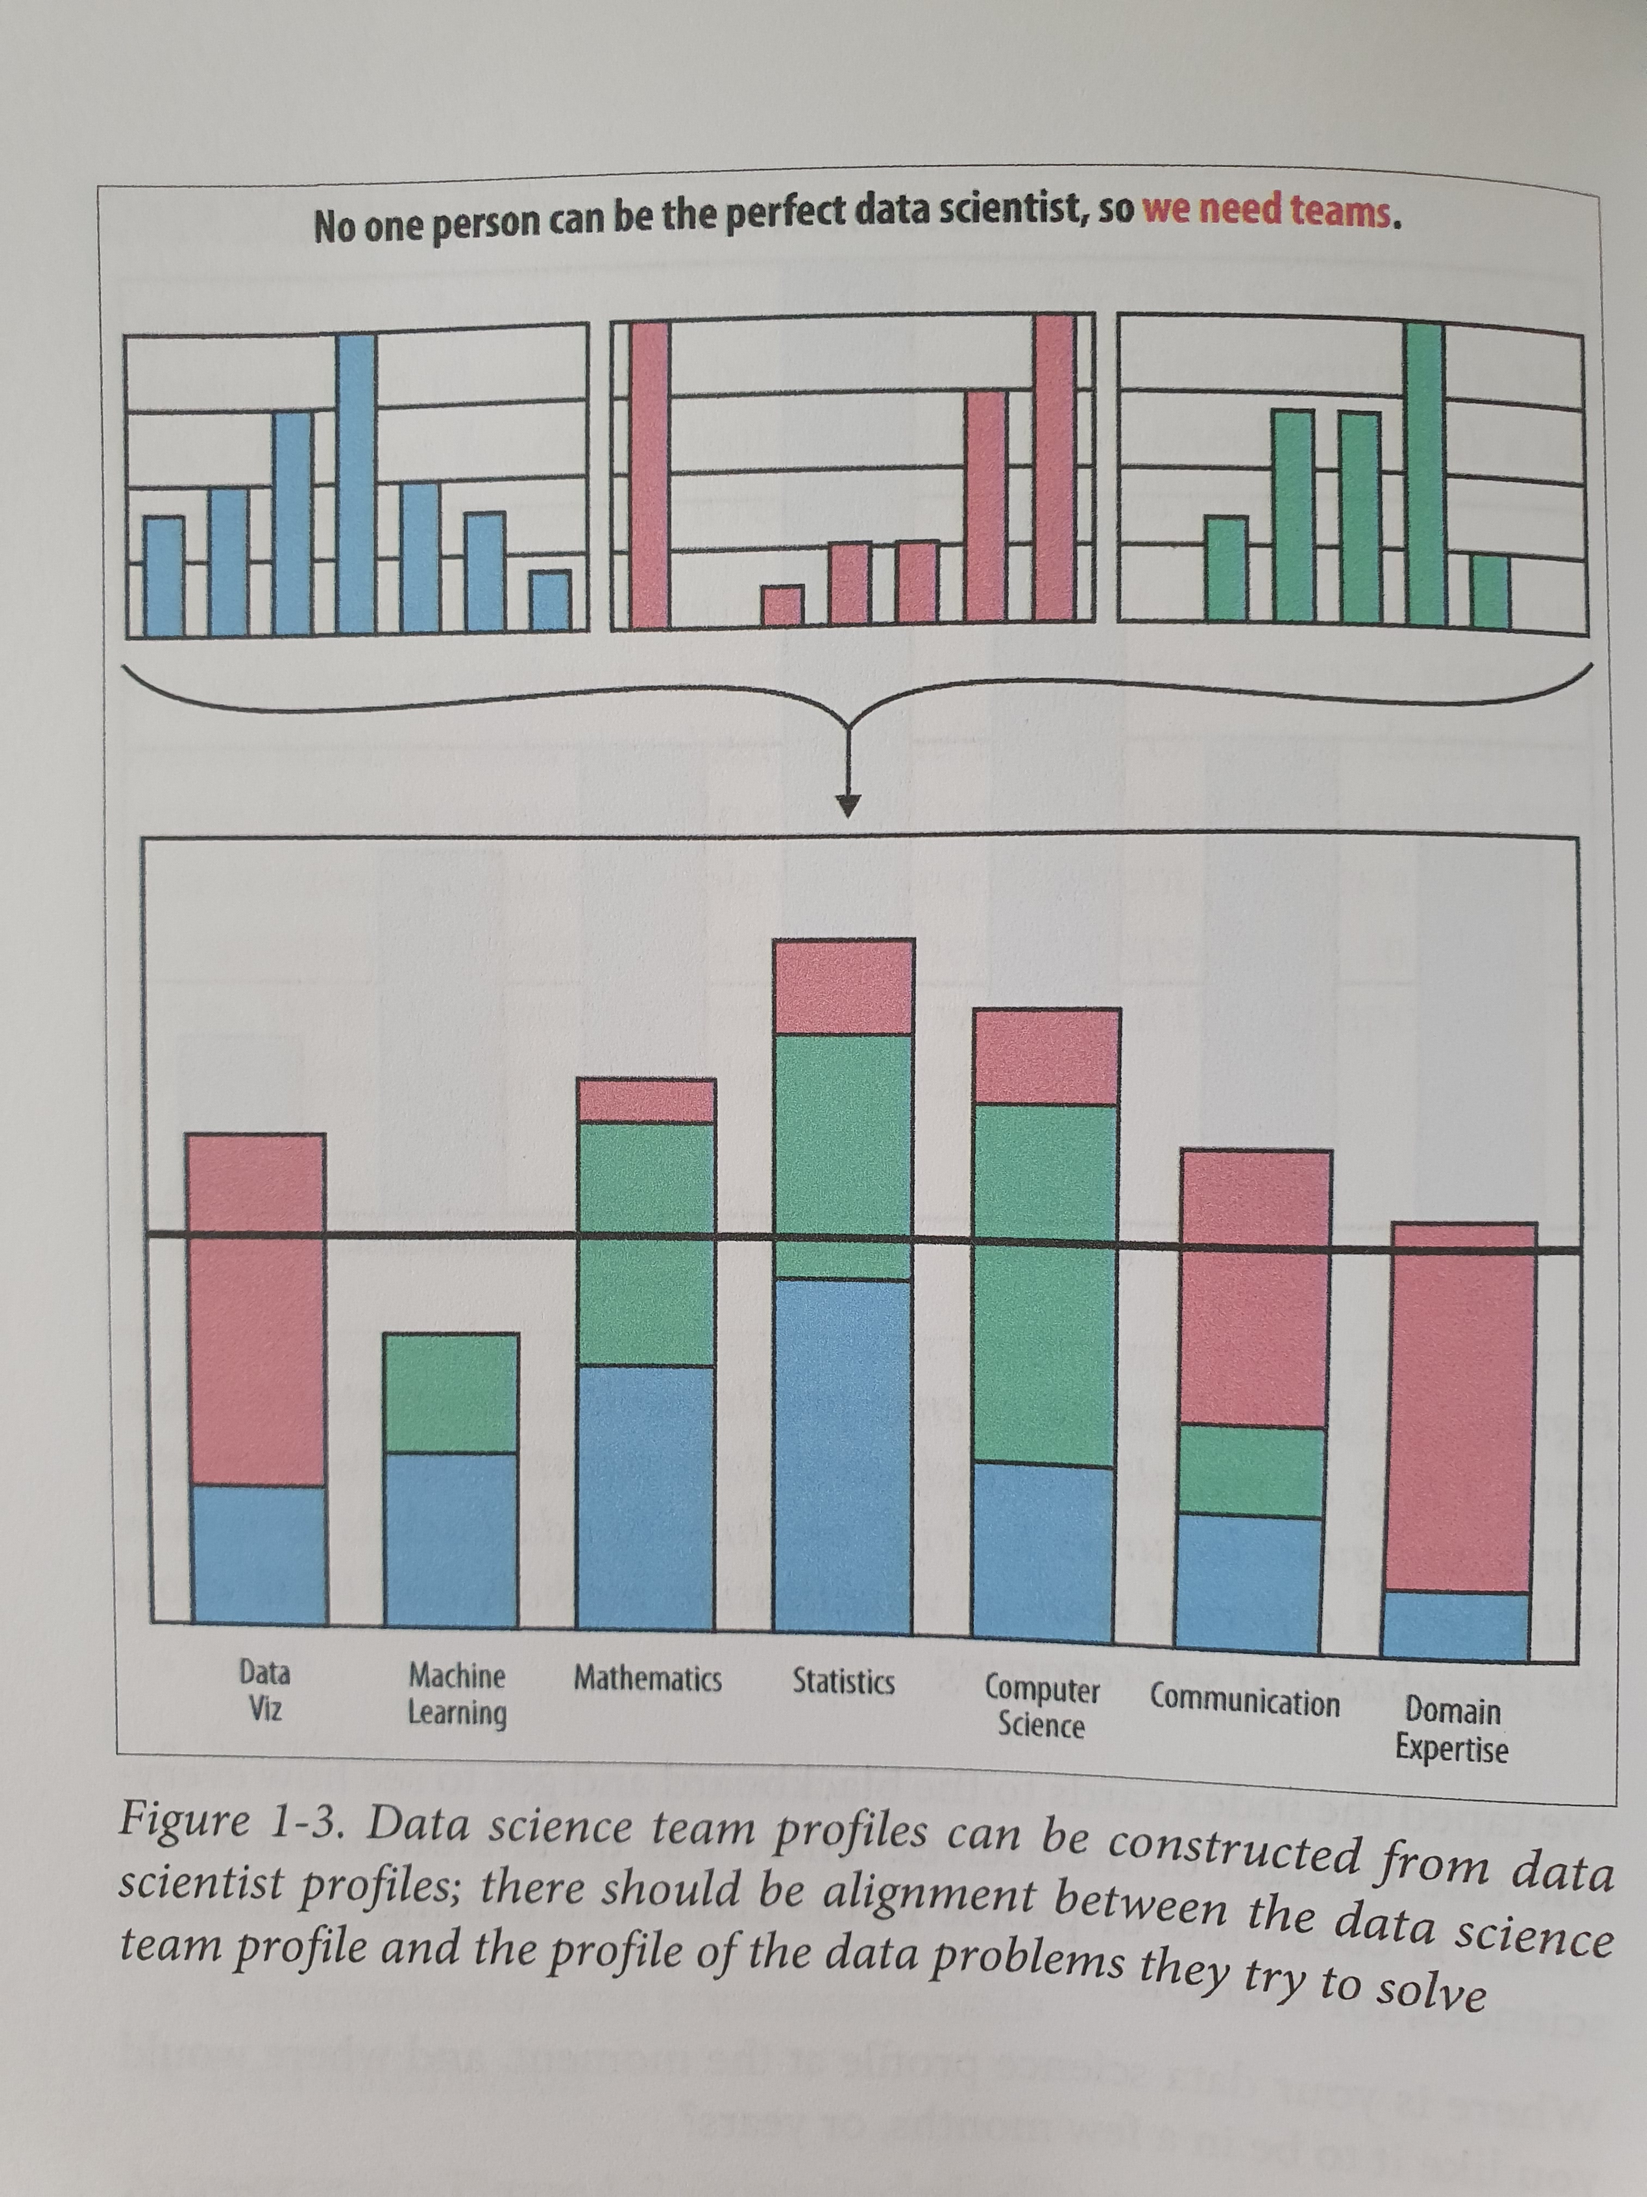
No Single Person Knows Everything
Conclusion
We must build teams with the right expertise
We must be more flexible with our teams
- not just rigid forever placements
We must be flexible sharing our expertise
We need to spend more time communicating
(as different people have different expertise)
We need to continuously improve our skills as software engineers
We must get better at sharing our learning (particularly the exotic stuff)
We should think strategically about skills
Please excuse the wobbly layout, it is a picture of the page from the book
O’Neil and Schutt:
Doing Data Science
O’Reilly

Slide 31
Thank you
 | http://purl.org/net/epubs/work/65961940
Facebook: Science and Technology Facilities Council
There was a twitter link here but twitter doesn’t exist any more
YouTube: Science and Technology Facilities Council

Slide 32
Helpful
TLA and
ETLA summary
Abbrev. | Expansion | Domain
CFD | Computational Fluid Dynamics | Scientific Computing
CRS | Coordinate Reference System | Geospatial
DT | Digital Twin | Computational Modelling
EDA | Exploratory Data Analysis | Statistics
EFTA | European Free Trade Association | European Union
ETLA | Extended TLA | Computing
FAIR | Findable, Accessible, Interoperable, Reusable | Publishing
HPC | High Performance Computing | Computing
IDE | Integrated Development Environment | Software Engineering
LES | Large Eddy Simulation | Atmospheric Modelling
MPI | Message Passing Interface | Computing
PEP | Python Enhancement Proposal | Python
QA | Quality Assurance
RFC | Request For Comments | www.ietf.org
RSE | Research Software Engineer | Software Engineering
SAFe | Scaled Agile Framework | Scaled Agile
TDD | Test Driven Design/Development | Software Engineering
TLA | Three Letter Abbreviation/Acronym | Computing
ULP | Units in Least Precision | Numeric Analysis
VDM | Vienna Development Method | IBM

