Slide 1
Integrating CLS Data Acquisition Systems with ScienceStudio
Elder Matias

Slide 2
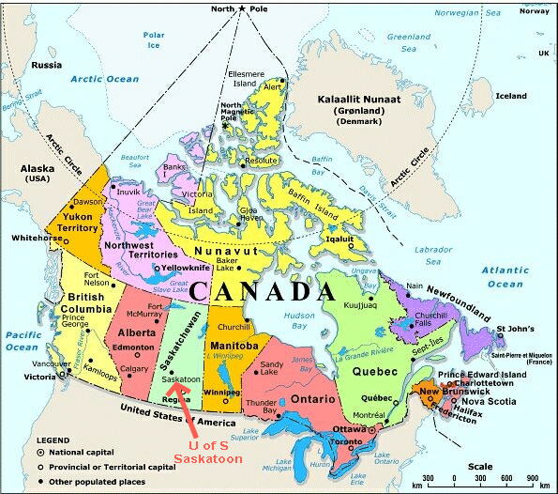
Where is Saskatoon?

Slide 3
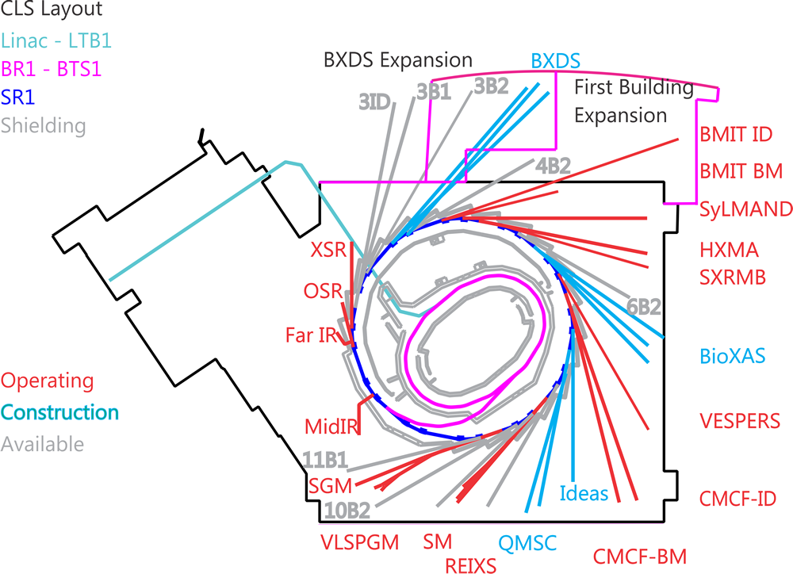
Canadian Light Source
Timeline:
2006 – First Publication
2005 – First User
2004 – First Beamline
2003 – First Light
2002 – BR1
1999 – Funding

Slide 4
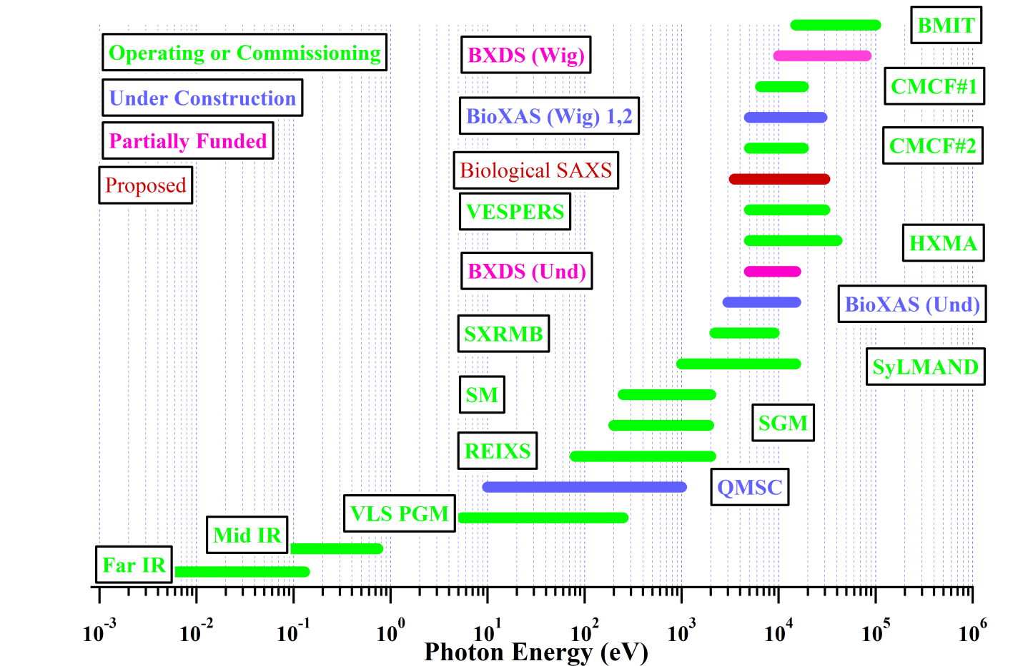
Beamline Energy Range

Slide 5
Structure
High Level (EDM, Qt, Root, Aquaman, ScienceStudio)
Scan and Data Management Libraries
EPICS PV
(Abstract PVs)
EPICS Low Level
(Motor and Detector PVs)
EPICS Drivers
(vendor drivers)

Slide 6
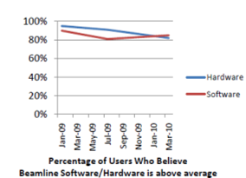
Human Factors focus
Continue to move from
device based to task
based GUIs
Increased layers of
abstraction
Priority has been tailoring GUI applications to specific beamlines, we now need to look at a common look and
feel across the facility

Slide 7
We Changed the Question...
Drop corresponds to new beamlines coming on and shift in interface.

Slide 8
The Challenges
Beamline controls are very homogenous
More variability on data acquisition:
  Common elements:
    EPICS at the device layer
    Common sign-on and home directories (Centrify)
  Shared elements:
    Most use our standard scanning engine
    LOC interface for user built endstation
  Variable elements:
    Actual experiment control
Improved post-experiment data access

Slide 9
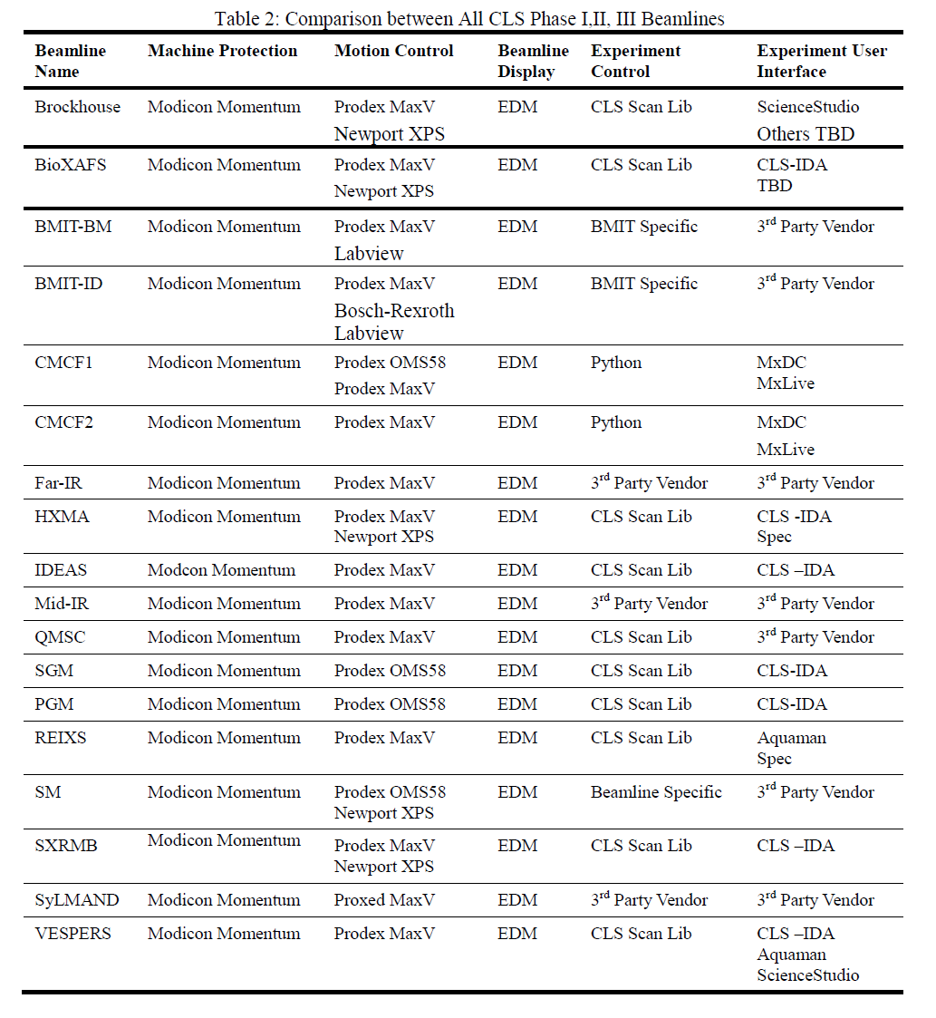

Slide 10
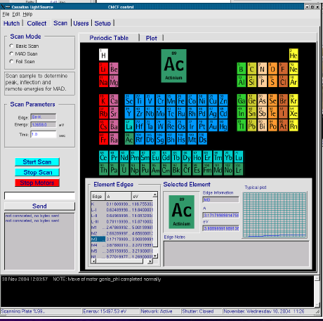
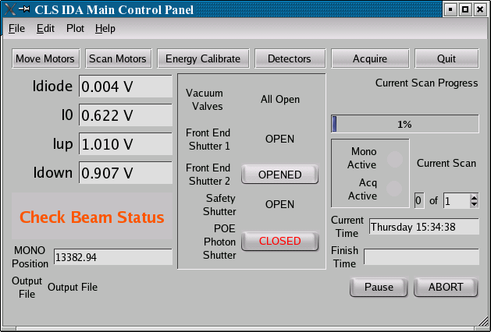
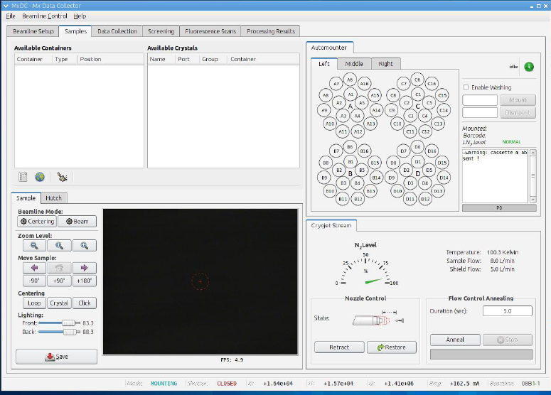
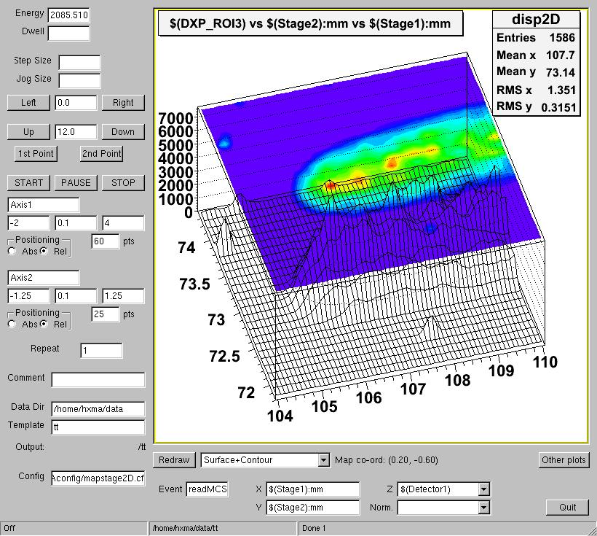
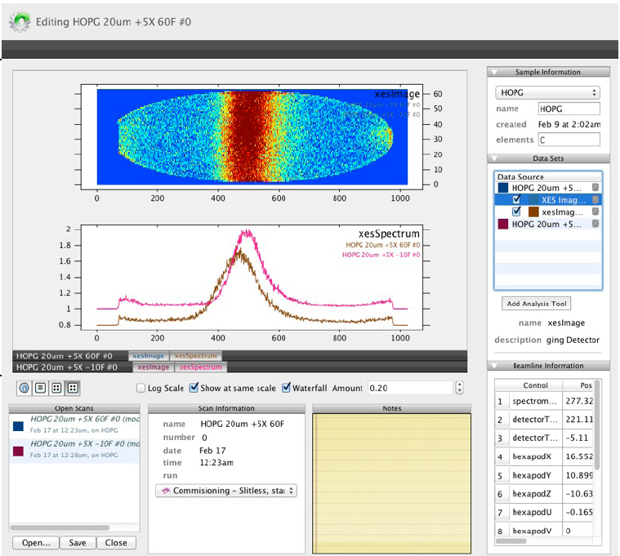
How have we approach the Experiment user Interface?
Small team, we need to leverage and standardise
Focus on human factors
Flexibility where we have partners
Borland
Python
Qt and Root based
Qt (Aquamn)

Slide 11
What is Science Studio?
Partnership between CLS, University of Western Ontario, IBM Canada, IBM Research, and LNLS
Database for experiment information
Common object models & rest interface
Plug-in modules
Multi-laboratory capability
Includes:
  People (production)
  Facility Info (production)
  Training (production)
  Data (Florescence and Diffraction)
  Proposal (prototyped)
  Schedule (prototyped)

Slide 12
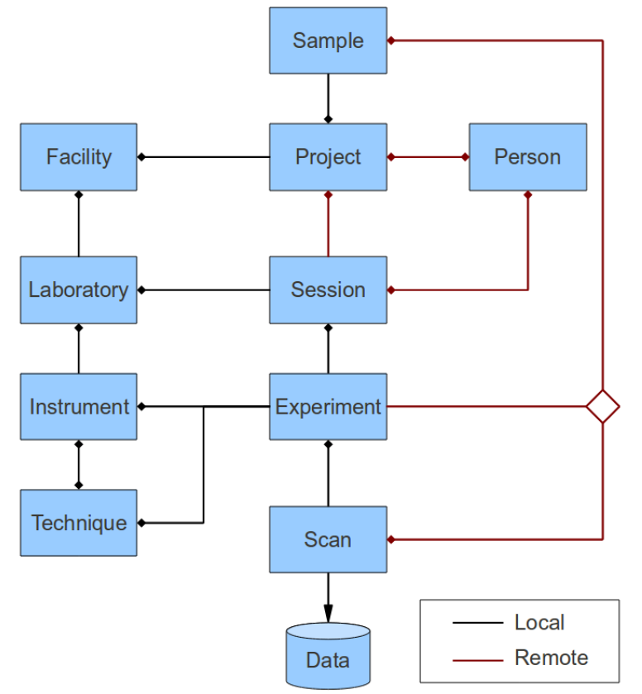
Current High-level Data Model
CLS
beamline
endstation

Slide 13
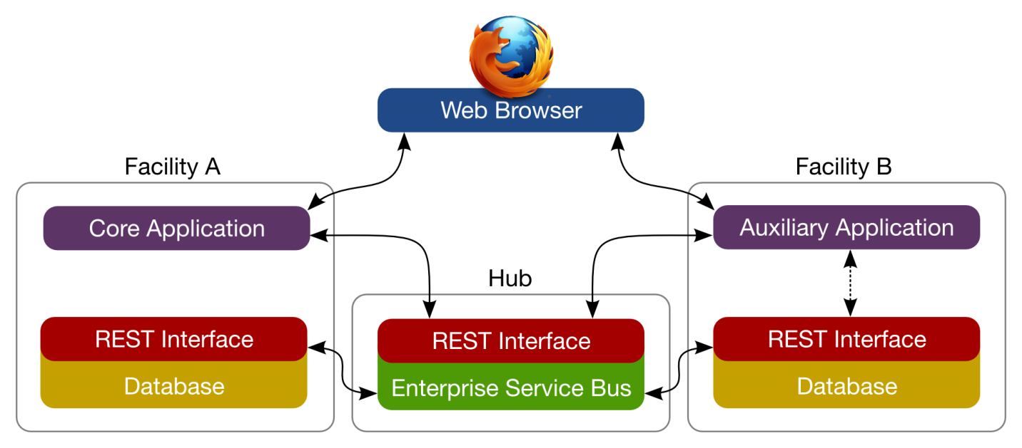
Science Studio
Applications are integrated through REST Interface
Applications can either be data acquisition oriented or data analysis oriented
They can also occur across multiple sites

Slide 14
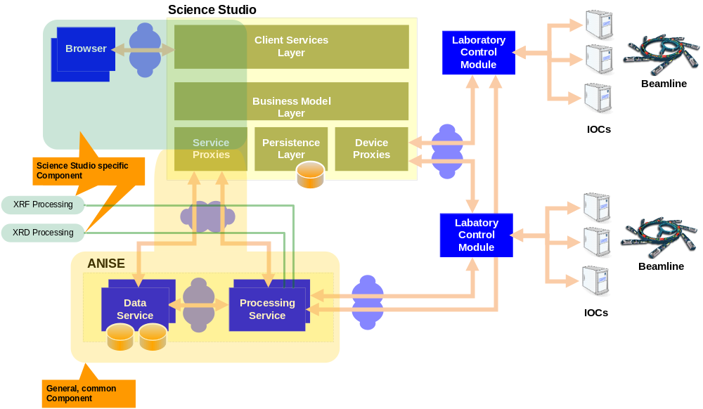
Science Studio Structures

Slide 15
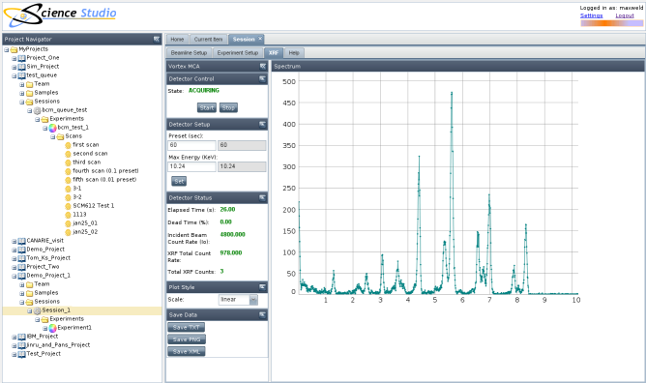
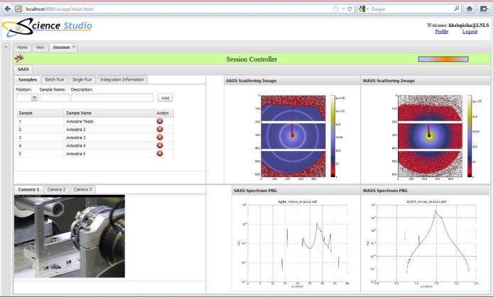
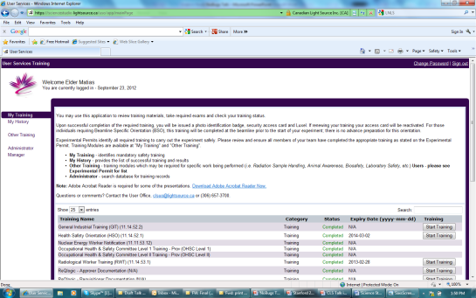
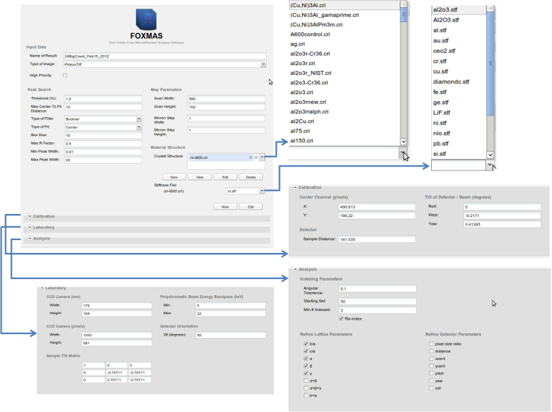
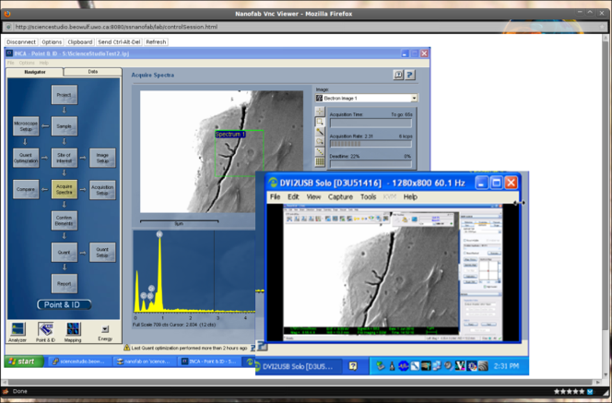
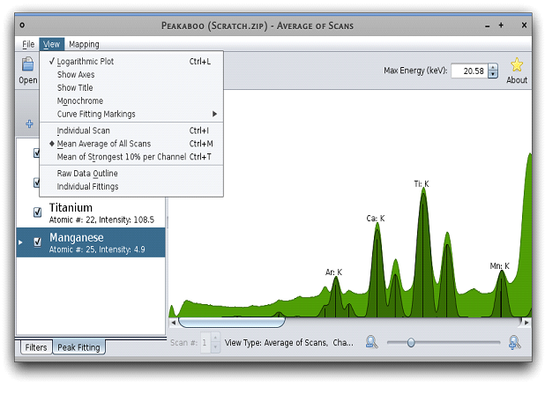
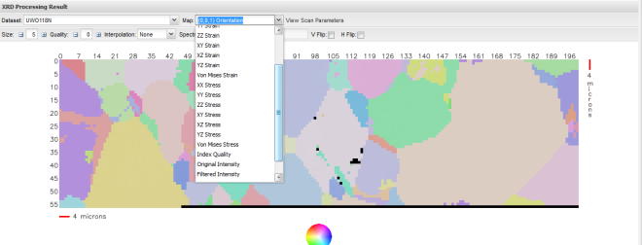
Some Example Applications
XRD/XRF by CLS
Training by CLS
Science Studio
Database
SAXS Implemented by LNLS
Web VNC integration of
Electron microscope
UWO NanoFab
By UWO/CLS
Foxmas by UWO/SharcNet
Peeakabook fitting software UWO

Slide 16
Next Step....
Integrate sufficient user office functionality to obtain more metadata
Add additional upload capabilities from existing applications
Add additional viewing capability
Integrate eduroam/access federation

Slide 17

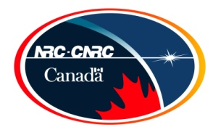




























Thank you for your time....
Funding Partners

Slide 18
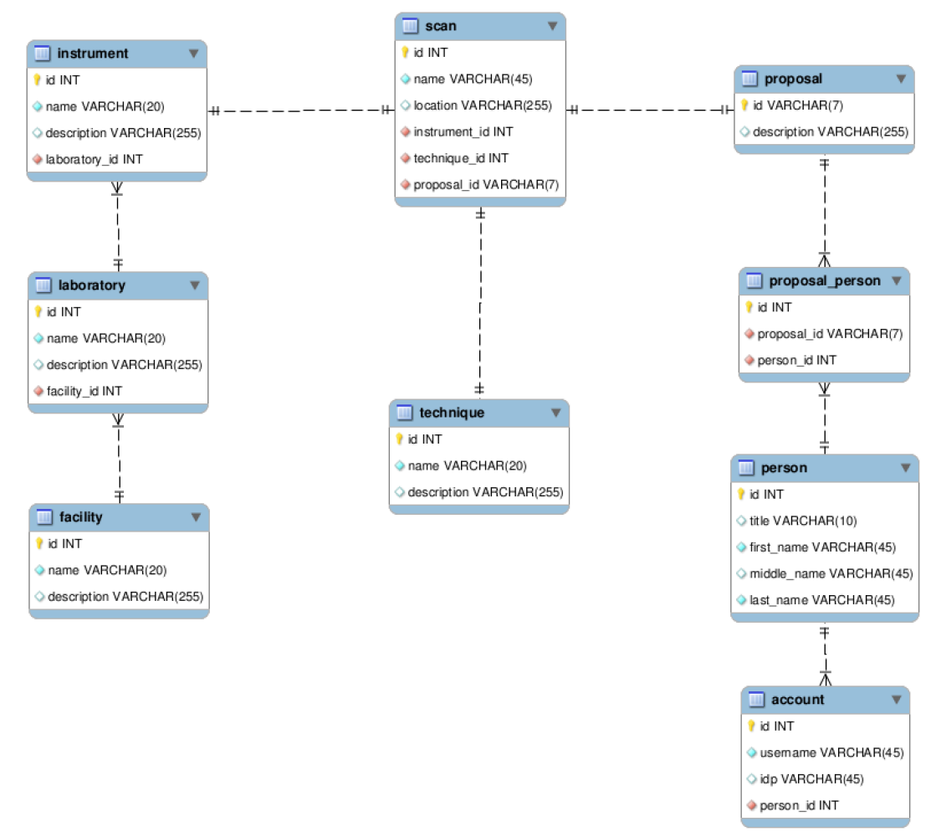
Potential Restructured Model
endstation
SGM beamline
CLS

Slide 19
Licensing Requirements
(CNSC - Oct 22, 2010)
Safety and Security Considerations
  Use of third party certificate for SSL encryption (Thawte)
  Integrated Video Feed of any area under remote control (OHS requirement)
  Single interface point between DMS and the beamline VLANs with security.
  Access is limited to specific experiment permit and only to members of experiment
  Remote user contact (phone number and e-mail must be available within the system)
  Remote access user training
  Audit records of access times and experiment activities
  Devices controllable limited to only those needed to perform the experiment

